Slide 1
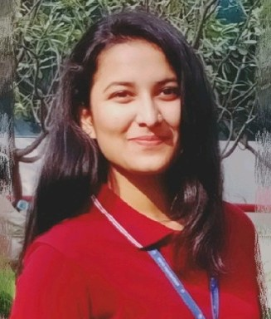



Vaishnavi Dhumal
Analyst/Software Engineer
Bachelor of Engineering
Electrical-2018-2022
Skills
Java 8 | Java Basics, OOPS, Collections, Arrays, Loops, Lambda Exp, Stream API Junit, Mockito, Servlets
Spring core | IOC & Dependency Injection, Autowire
Spring REST | REST controllers, Implementation of GET, POST, PUT & DELETE, Bean Validation & Exception Handling, Testing Services, Controller & Repository layer
Spring Boot Microservices | Spring Boot Starters, annotations, Messaging Service, Sync/Async comms, Swagger API specifications
Spring Cloud | Eureka, Netflix Ribbon, Feign Client, Hystrix, Zuul & Config Server
Angular | Components, Services, Modules, Routing, Forms & Validation
Database | My SQL Basics
UI Tech | HTML 5 & CSS 3,JavaScript, ES6 & TypeScript Reusable templates, Optimized UI Designed
Tools | Git, Postman, Maven, IDE
Add On skills | Presentation, Communications, Team management, Peer learning
Mumbai
vaishnavi-deepak.dhumal@capgemini.com
7350160600
A4
Hands on experience in creating microservices with Springboot, Spring Security, Spring Cloud API Gateway, Eureka server.
Experience in creating Single page Web Application in Angular
Experience in creating documentation with Java docs and swagger and in unit testing using Junit, Mockito including code quality compliance using Sonar cube
E-Commerce Shopping Cart Application
Developed Completed end to end case study of Shopping Cart Application Using spring microservices and AngularJs with MYSQl as database along authentication, Swagger and payment testing, responsive UI with CSS and Angular used for user interface.
E-Commerce Insurance Application
Developed E-Commerce Insurance Application Using spring boot and AngularJs with MYSQl as database in agile methodology of software development model.
Check out my work on GitHub & Video Profile

